Slide 1
Breaking and Securing .NET Applications

Slide 2
Kailash Bohara
Cybersecurity Engineer at Cedar Gate Technologies
Occasional bug bounty hunter
Reported bugs and rewarded by:
Facebook
Google
Microsoft
AWS
Zero Day Flaws in couple of systems
CVE-2020-10596 - Opencart
CVE-2020-18723 - Mdaemon Webmail Service
CVE-2020-18724 - Mdaemon Webmail Service
CVE-2021-46065 - Zoho ManageEngine ServiceDesk Plus
CVE-2024-2301 - HP Printers

Slide 3
Agenda of Session
Introduction to OWASP Standard
Common misconfigurations in .NET applications
Supply Chain Risks
Secure File Upload Practices

Slide 4
Application Security Scanning
SAST
DAST
SCA
And others..

Slide 5
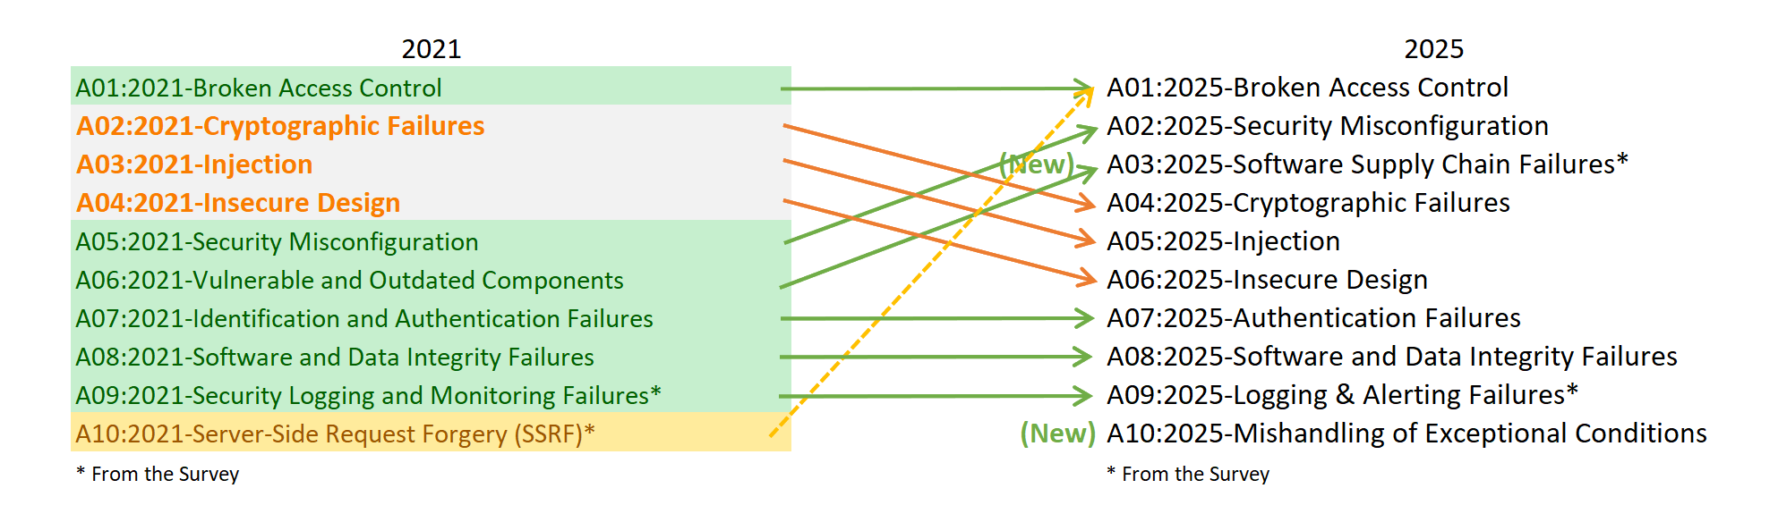
OWASP Top 10

Slide 6
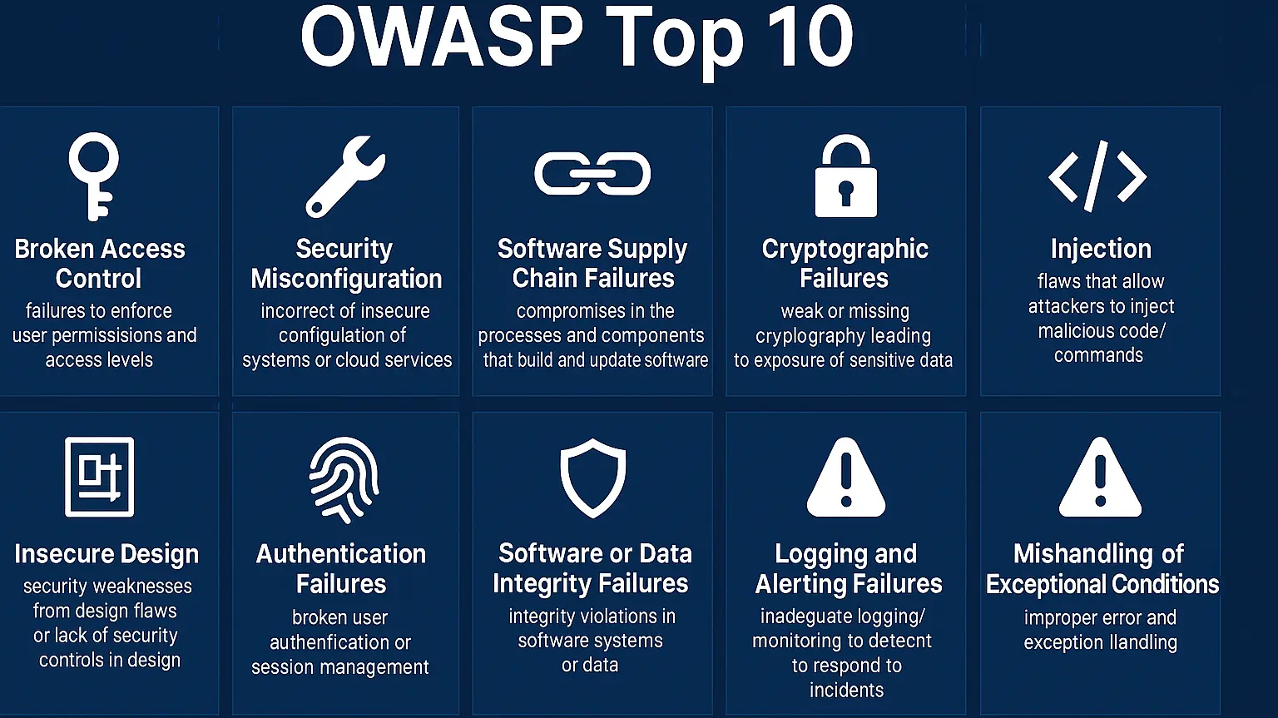

Slide 7
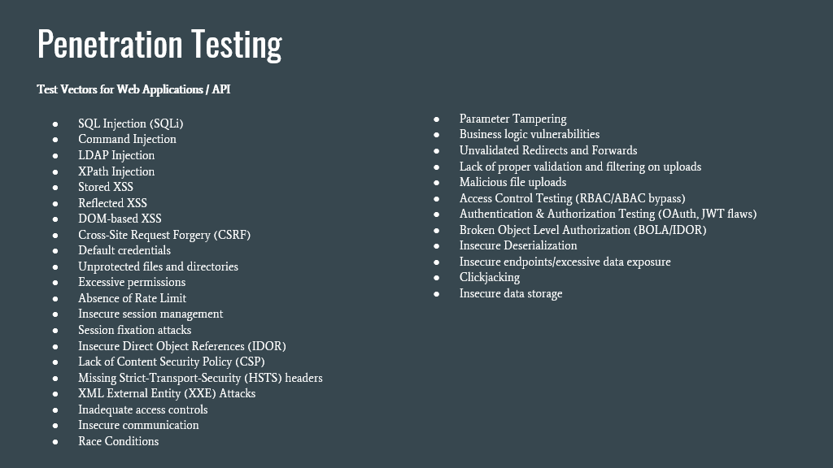

Slide 8
OWASP Resources for .NET Security
DotNet Security Cheat Sheet - https://cheatsheetseries.owasp.org/cheatsheets/DotNet_Security_Cheat_Sheet.html
Password Storage Cheat Sheet - https://cheatsheetseries.owasp.org/cheatsheets/Password_Storage_Cheat_Sheet.html
Session Management Cheat Sheet - https://cheatsheetseries.owasp.org/cheatsheets/Session_Management_Cheat_Sheet.html

Slide 9
Security Headers

Slide 10
Security Headers
Security headers are directives utilized by web applications to configure the security defenses of web browsers.
Browsers can make it more difficult to exploit client-side vulnerabilities such as Cross-Site Scripting and Clickjacking.

Slide 11
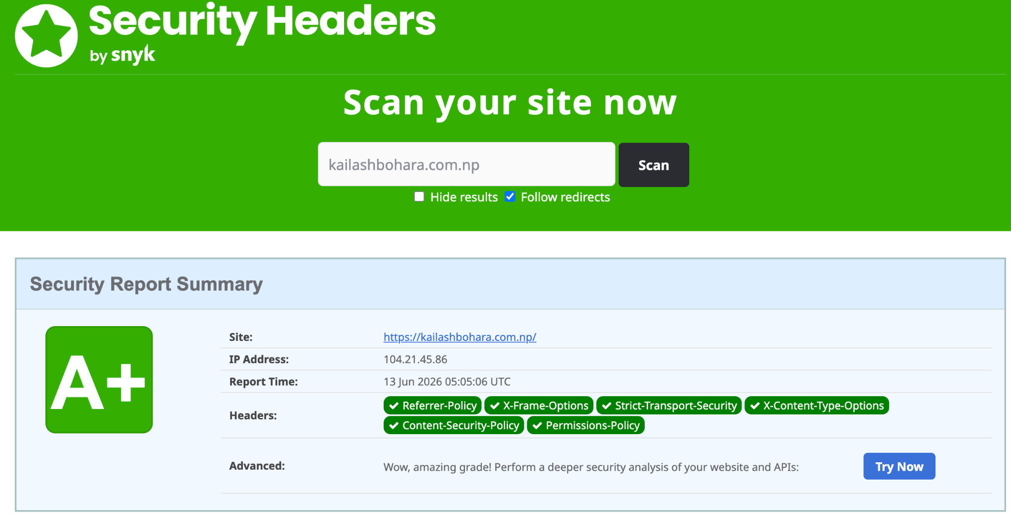
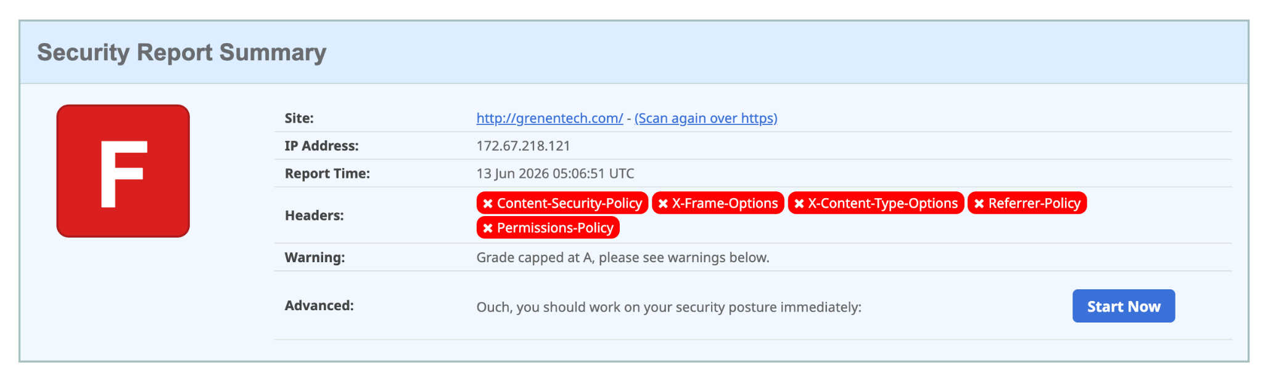

Slide 12
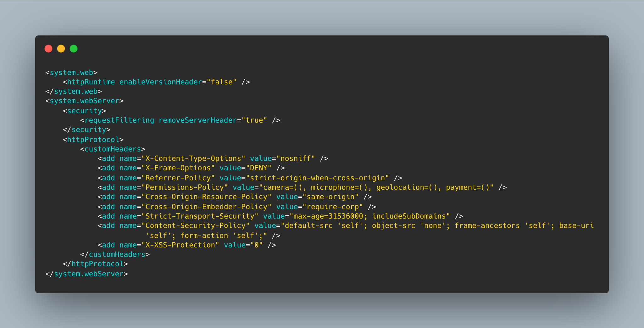

Slide 13
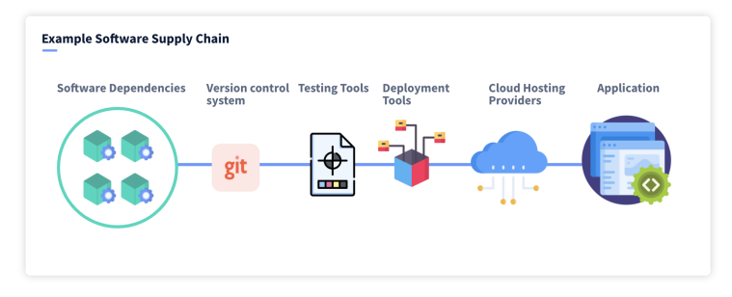
Software Supply Chain Risks

Slide 14
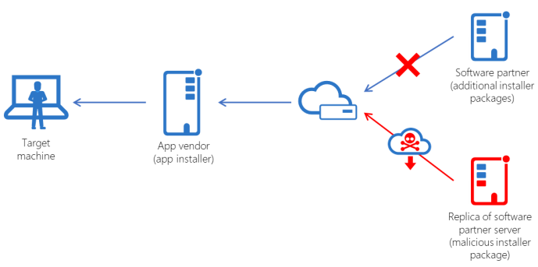
Software Supply Chain Risks

Slide 15
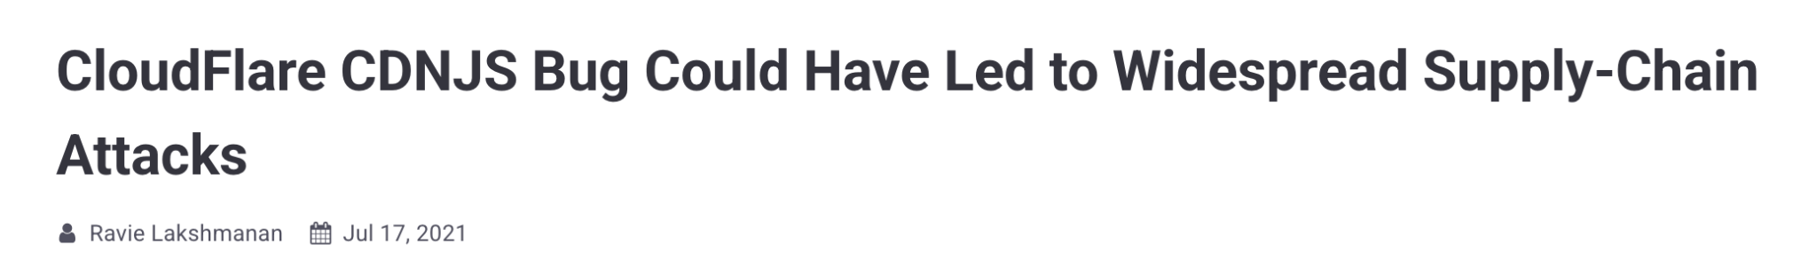
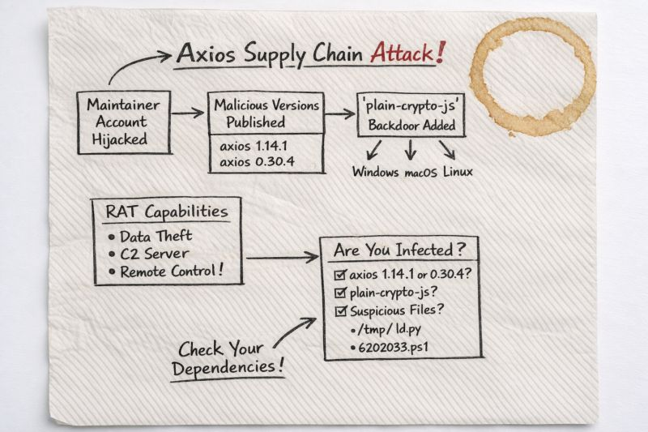
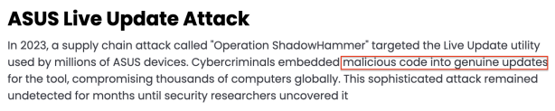

Software Supply Chain Risks

Slide 16
Software Supply Chain Risks Threats
Typosquatting in Packages
A malicious person can create a package with a similar name to a popular package. For example, Newtonsoft.Json can be replaced by Newtomsoft.Json or Newtomsoft-Json
Compromising maintainer Account
Approving PR in Github
No Practices of SCA scan
Unaware of used packages, libraries and open source codes.
Lack of Security testing
Missing concept software inventory or SCA (Software Component Analysis)
Missing software bill of materials (SBOM)

Slide 17
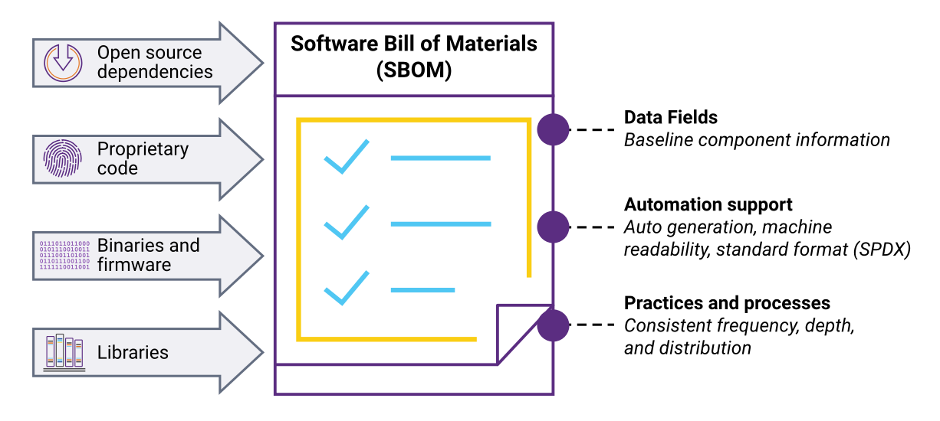
What is SBOM
A collection of all the components, libraries and software dependency that is used in a software
Gives visibility of used components in our softwares

Slide 18
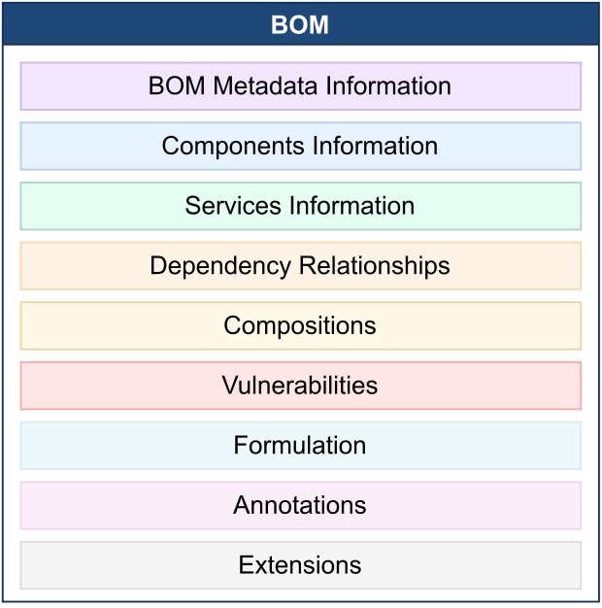
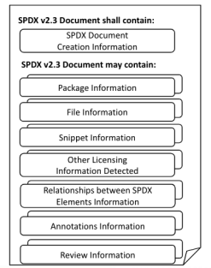
SBOM Formats/Standards
Cyclone DX
Software Package Data Exchange (SPDX)

Slide 19
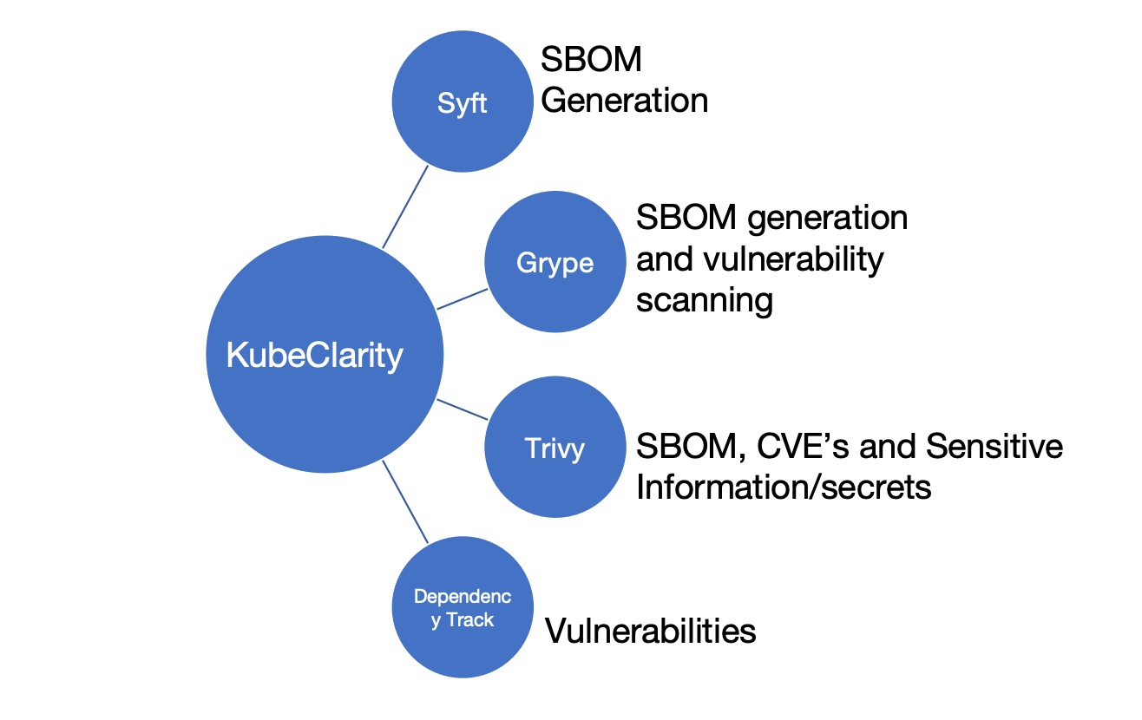
Scanning Tools
Kubeclarity
Anchor
Clair
Dagda
Snyk
Black Duck
Veracode
And more….

Slide 20
Defending Supply Chain Risks A03-2025: Software Supply Chain Failures
Edit the .csproj or other package version location (Directory.Packages.props) with a newer version containing a security fix.
dotnet restore - runs a security audit
Run the dotnet package update --vulnerable command to update all vulnerable
Check the content of the NuGet package before installing it using a tool such as NuGet Package Explorer
Use a lock file to prevent using a different version of the package than the one you validated

Slide 21
File Upload Security

Slide 22
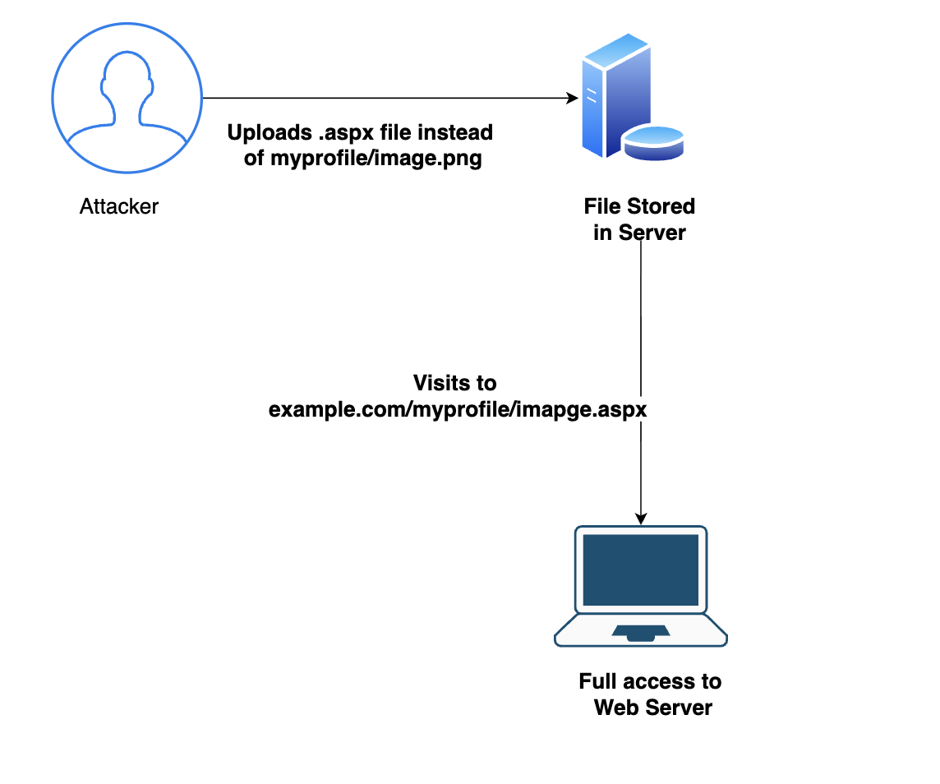
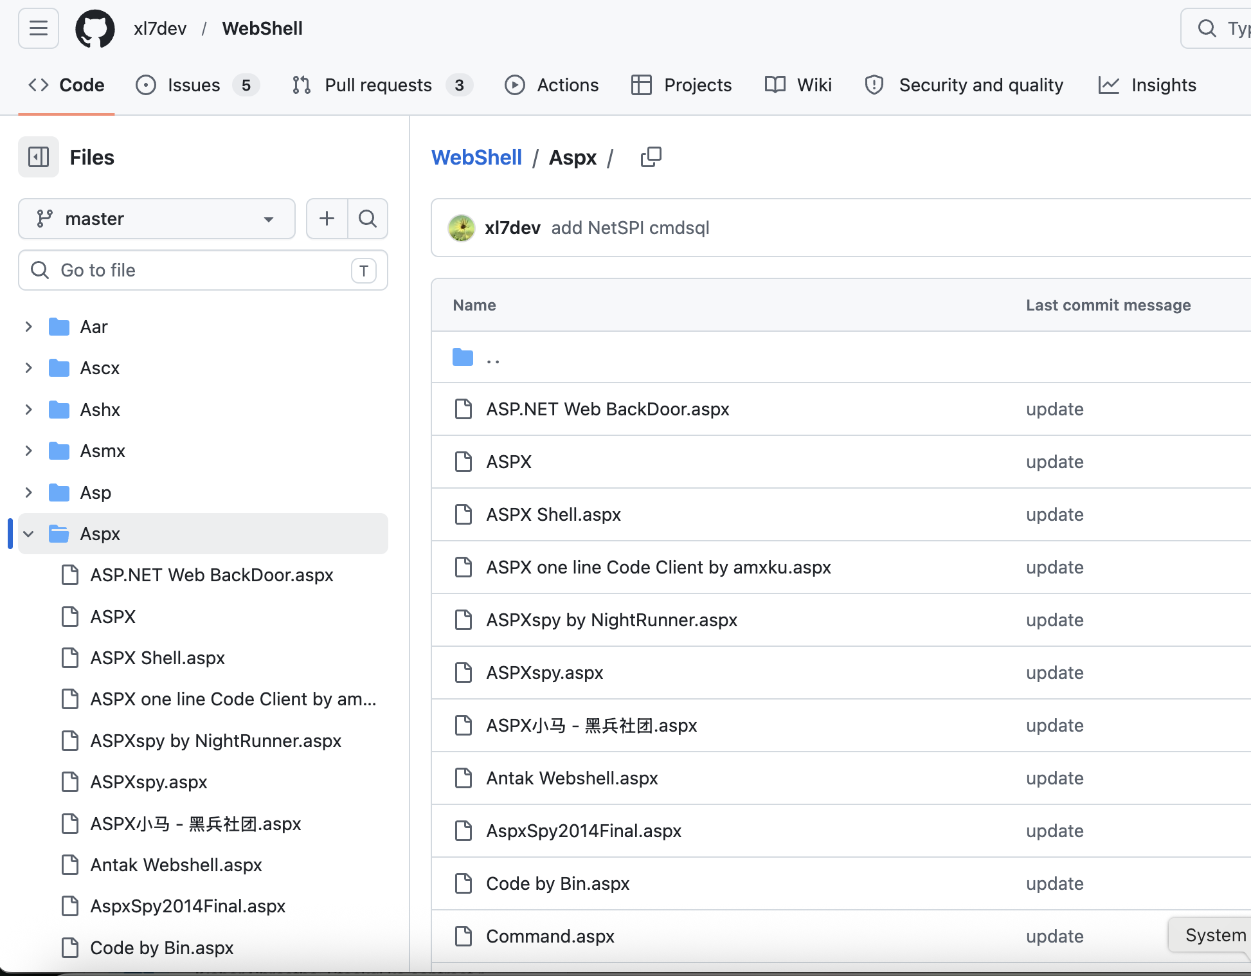
File Upload Risks

Slide 23
File Upload Best Practices
Accept only required file extensions. Examples:
(.png, .jpeg) - For images
.pdf, .csv - For Documents
Also check for Double extensions
photo.php.png
Check for file extension case:
photo.aSp
photo.aSpx

Slide 24
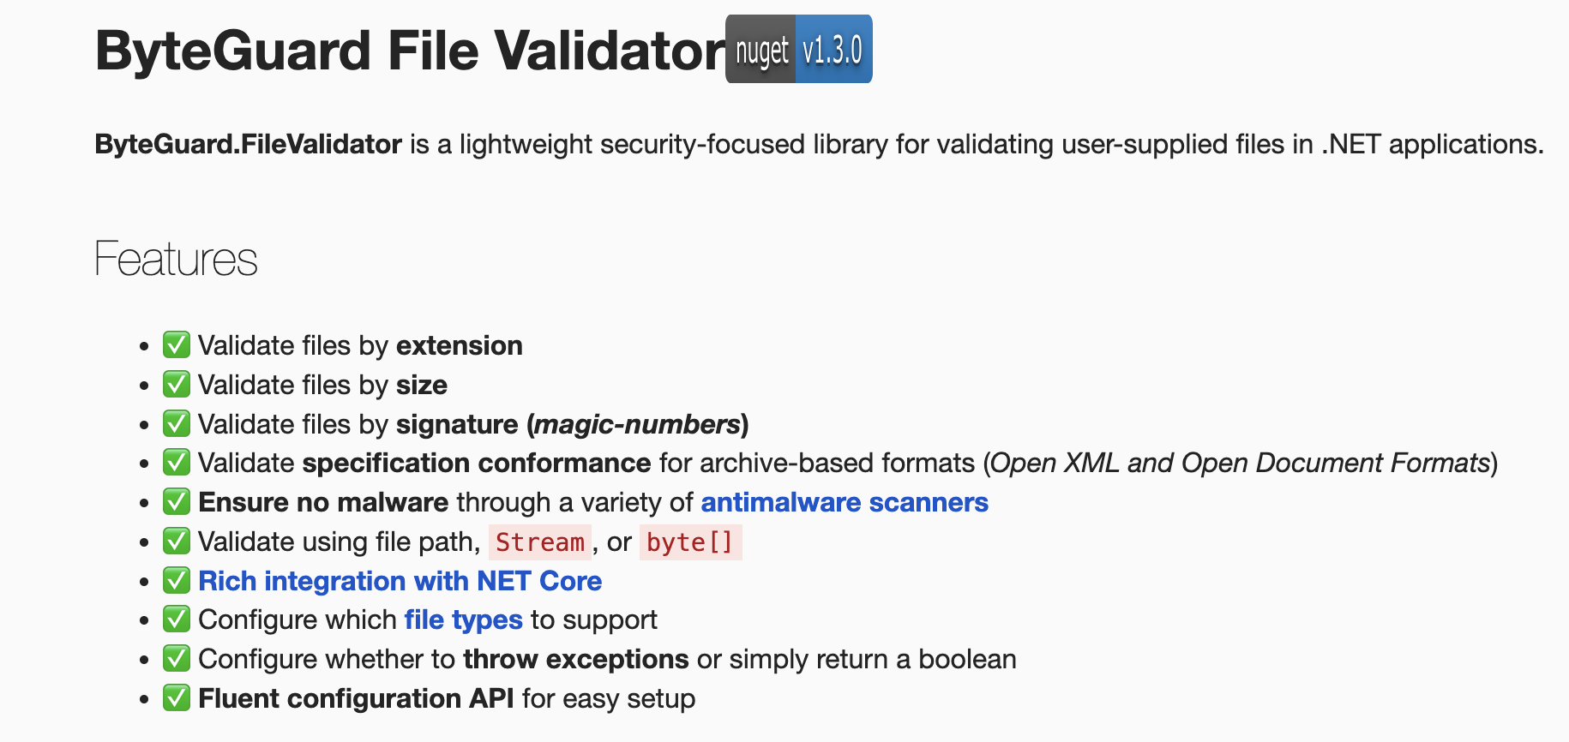
File Upload Best Practices
Accept only required file types. Examples:
(.png, .jpeg) - For images
.pdf, .csv - For Documents

Slide 25
File Upload Best Practices
Always Set file upload size limits.
Prevents application level DOS while rendering the file.
Saves Resource utilization

Slide 26
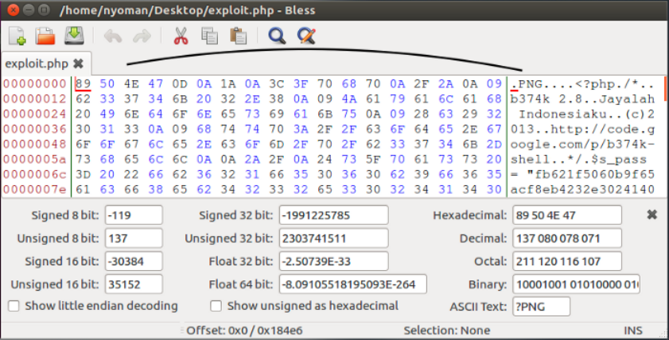
File Upload Best Practices
Checking file extension only is not enough, also check for Magic Bytes type.

Slide 27
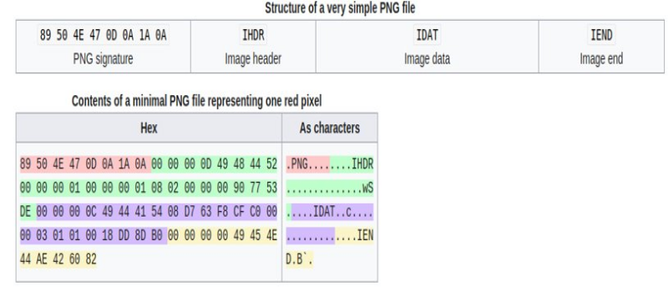
File Upload Best Practices
Checking file extension only is not enough, also check for Magic Bytes type.

Slide 28
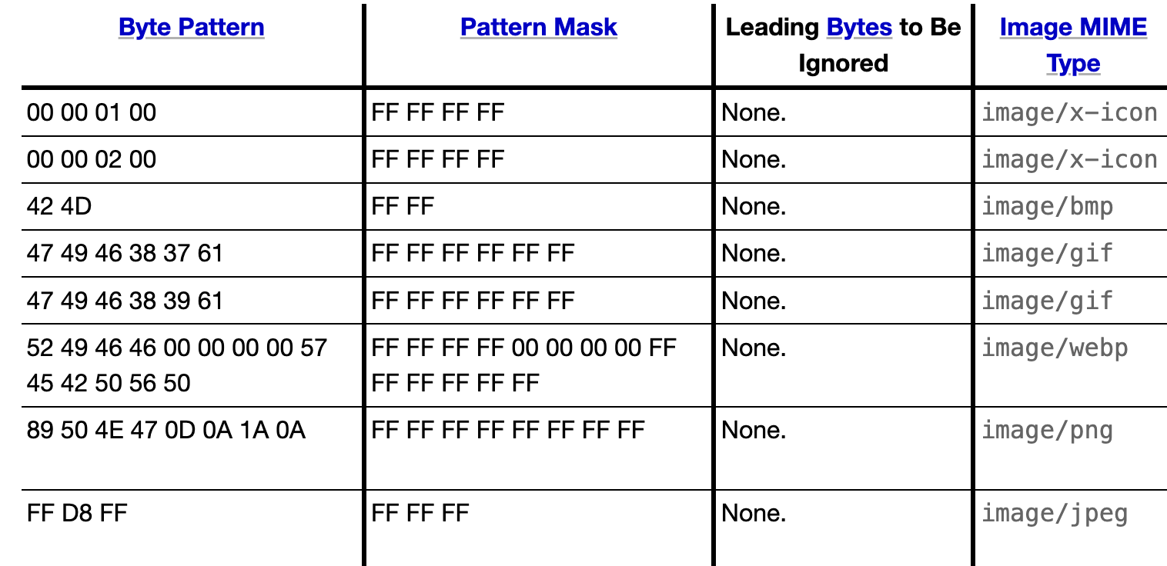
File Upload Best Practices
Validate files using Magic Bytes. They are unique to each file type.

Slide 29
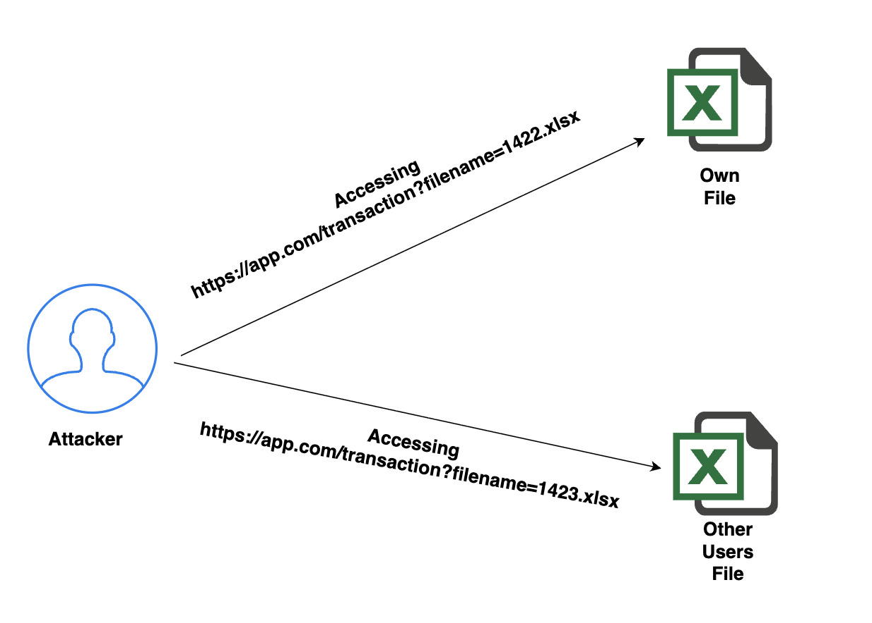
File Upload Best Practices
Never store filename with original names.
Use GUID/UUID for unguessable file names.
Example: 455548b4-1ebb-48ab-af64-edb20ad4e22c.xslx

Slide 30
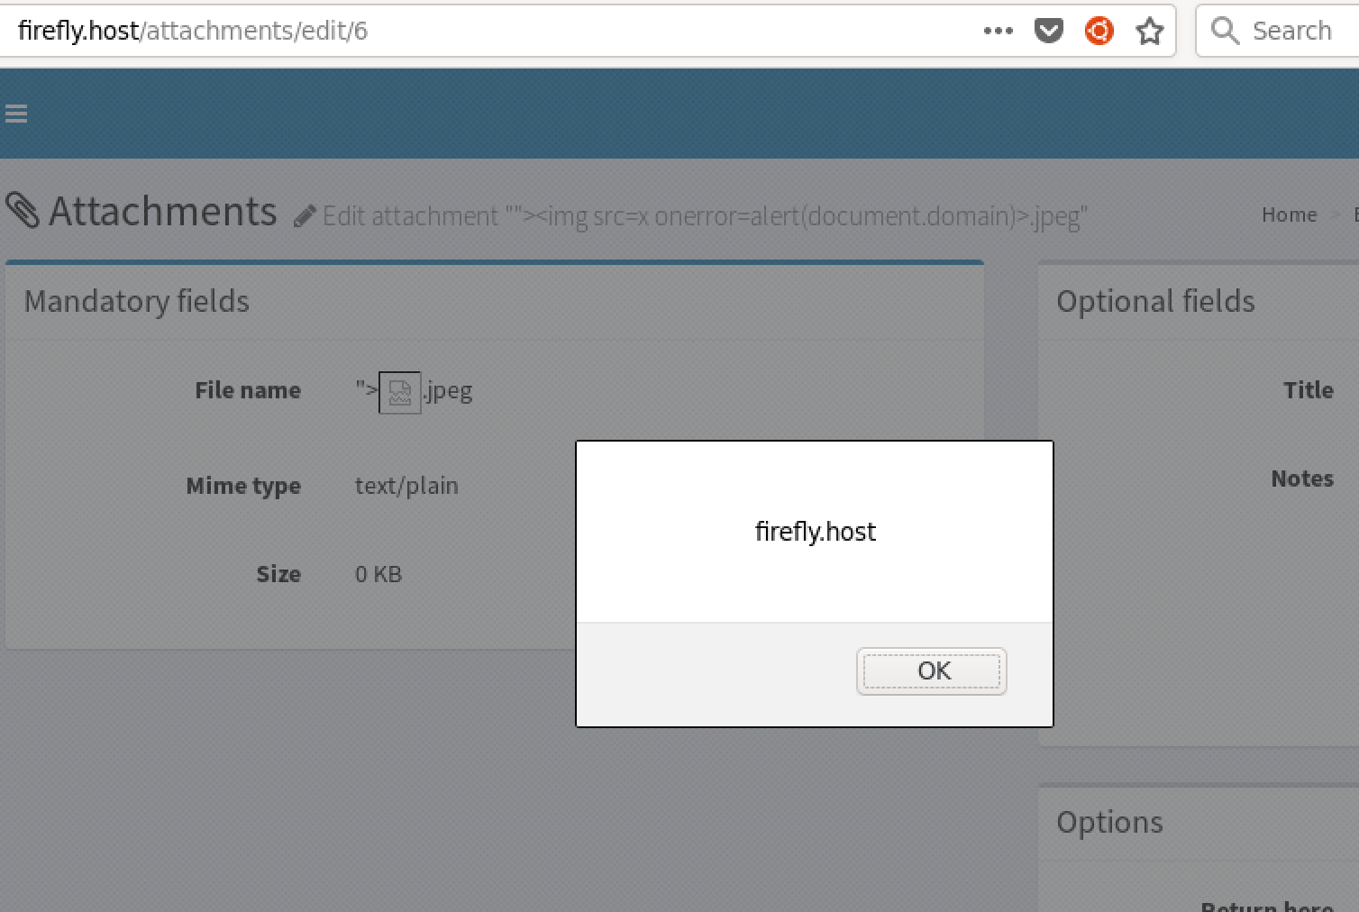
File Upload Best Practices
Validate filenames for any XSS or path traversal payloads.
Examples:
<script>alert(document.cookie)</script>.png
../../../../test.png
'waitfor delay '00:00:10'--.png
‘sleep(10)'.jpg

Slide 31






Resources

Slide 32
Questions?

